Slide 1
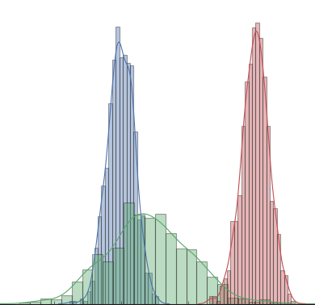
Mastering Probability and Statistics in Python
Notes:
1

Slide 2
Focus of the course
Fundamentals
Notes:
2

Slide 3
Focus of the course
Fundamentals
Pythonic
Notes:
3

Slide 4
Focus of the course
Fundamentals
Pythonic
Completeness
Notes:
4

Slide 5
PLUS of the Course
Easy Explanations, yet Complete
Notes:
5

Slide 6
Exclusions
Mathematical Derivations
Individual Model Derivations
Notes:
6

Slide 7
Contents
Probability vs Statistics
Sets
Experiments
Probability Models
Random Variables
Estimation
Notes:
7

